Slide 1

Screening Tool to Diagnose CKD
Group 4
Hang le
Parika Gupta
Mengyuan Lin
Vandana Agrawal

Slide 2
OBJECTIVE
Detect at-risk patients
Define risk factors/significant variables
Develop simple-to-use screening tool

Slide 3
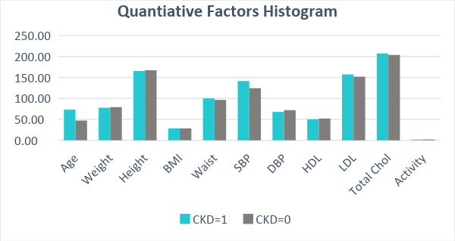
Higher Age
High Blood Pressure
“Bad” Cholesterol
141.5
73

Slide 4

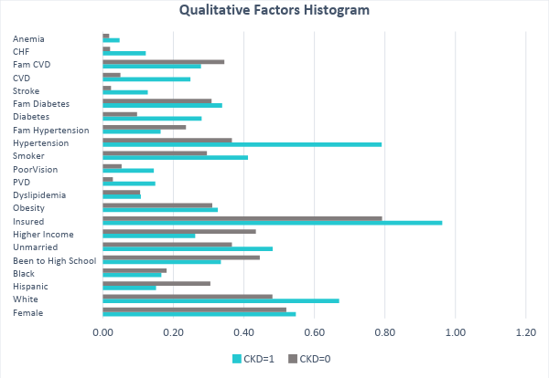



Hypertension
Female – 55%
CVD - 25% vs 5%
Diabetes - 28% vs 10%
79%
Higher Age

Slide 5
METHODOLOGY
5 steps
Step 1: Analyze the distribution of missing data & Imputation
Step 2: Split the data
Step 3: Build the models
Step 4: Select the best model for prediction
Step 5: Design Screening Tool

Slide 6
DATA ANALYSIS

Slide 7
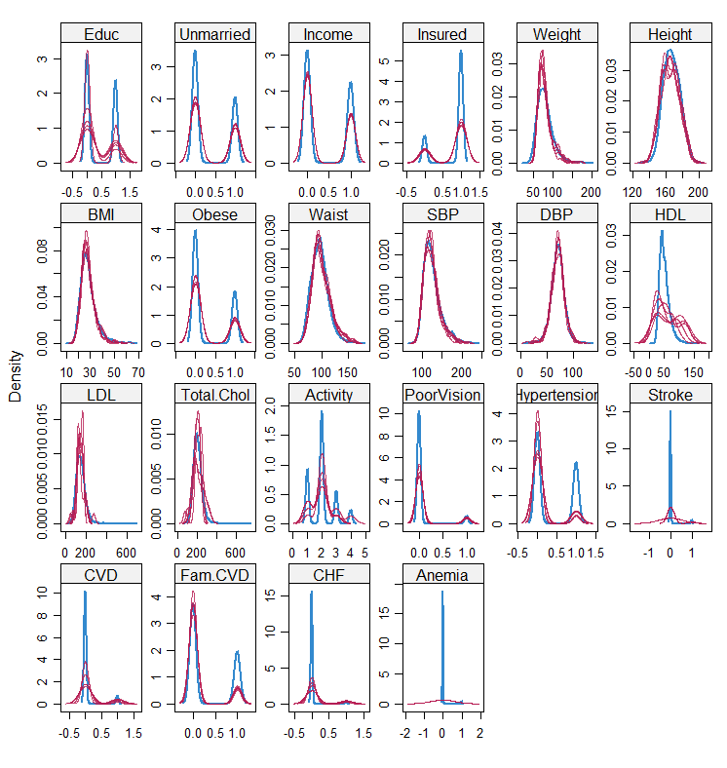
HANDLING MISSING VALUES
MULTIPLE IMPUTATION METHOD
It imputes data with a set of plausible values
Inspect the distributions of the original values and the imputed values
Notes:
Suppose we have X1, X2….Xk variables. If X1 has missing values, then it will be regressed on other variables X2 to Xk. It will consider the other variables as independent variables to predict the values for X1. The missing values in X1 will be then replaced by predictive values obtained using a complete() function.

Slide 8
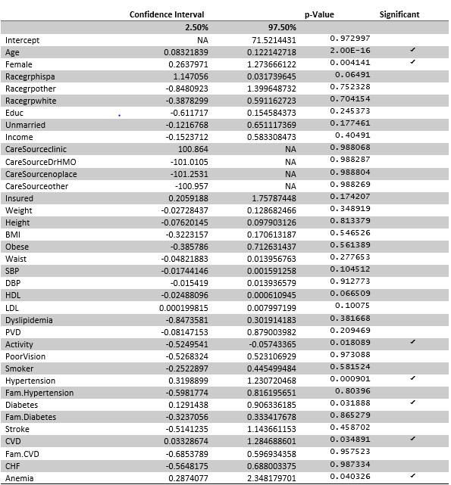
MODEL 1

Slide 9
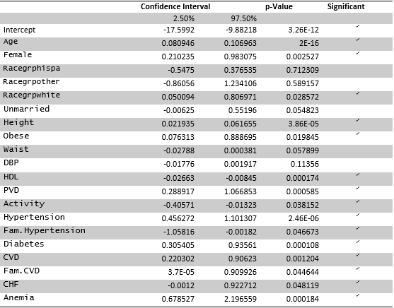
MODEL 3

Slide 10
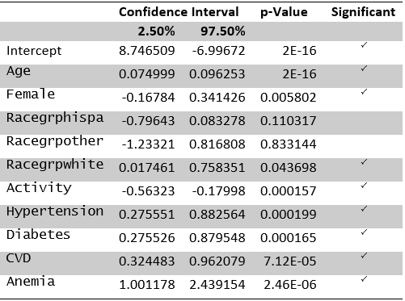
MODEL 4

Slide 11
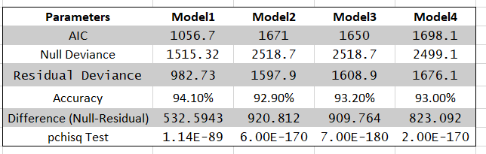
MODEL COMPARISON

Slide 12
PREDICTION
PROFIT VS ACCURACY

Slide 13
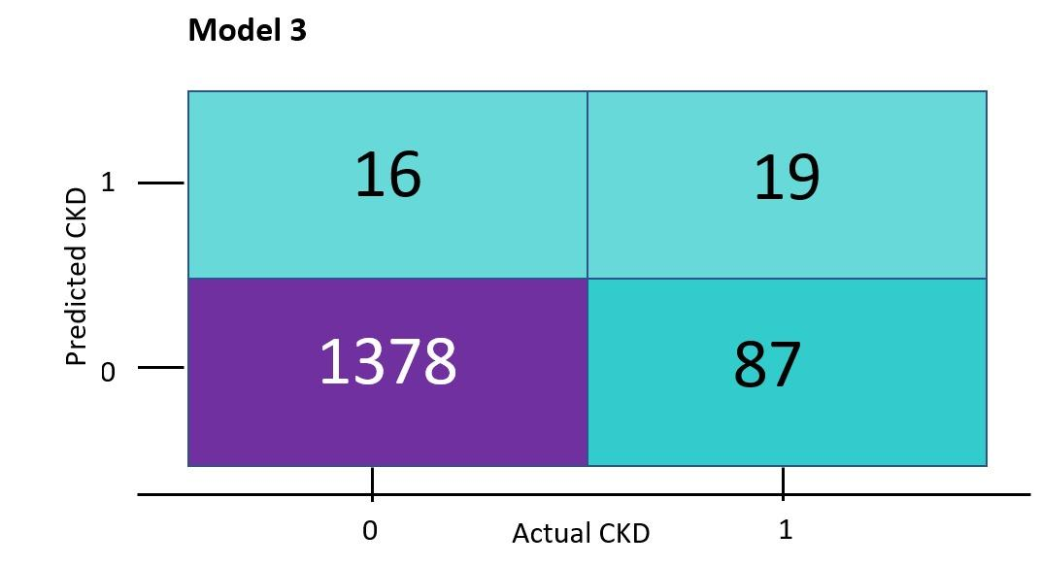
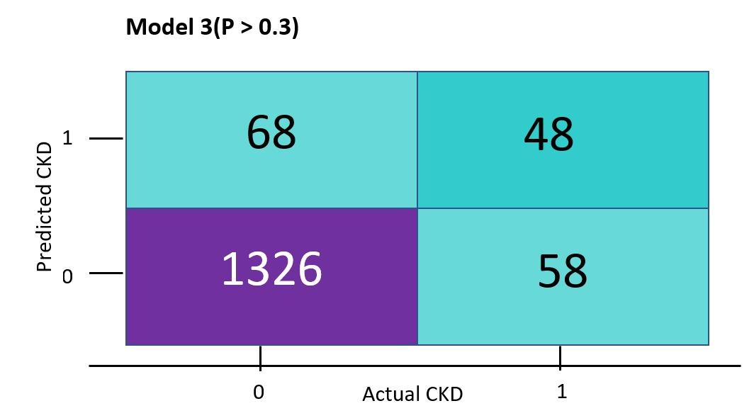
CONFUSION MATRIX

Slide 14
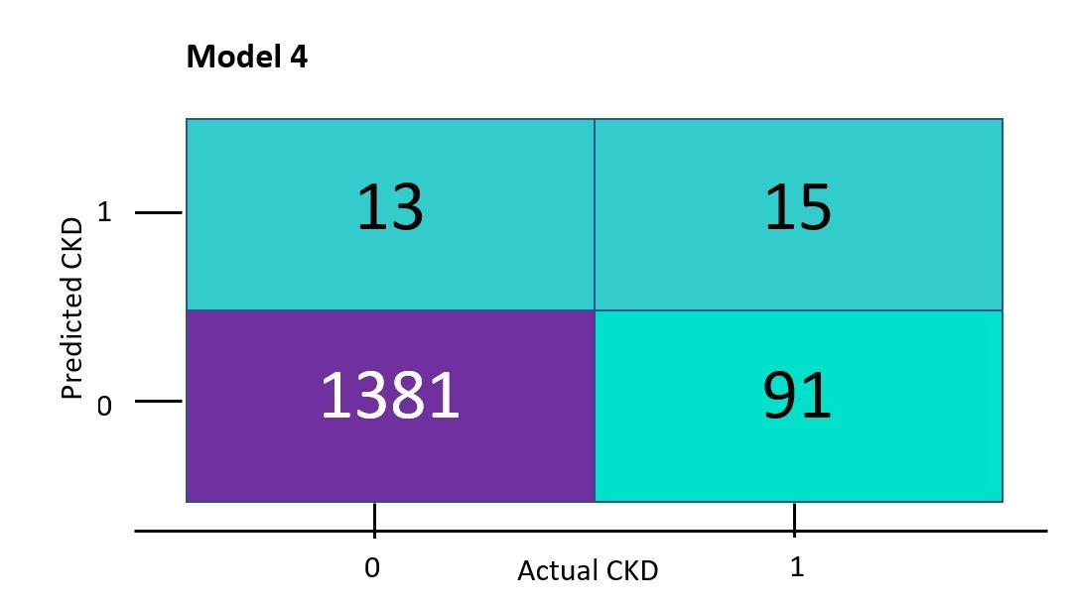
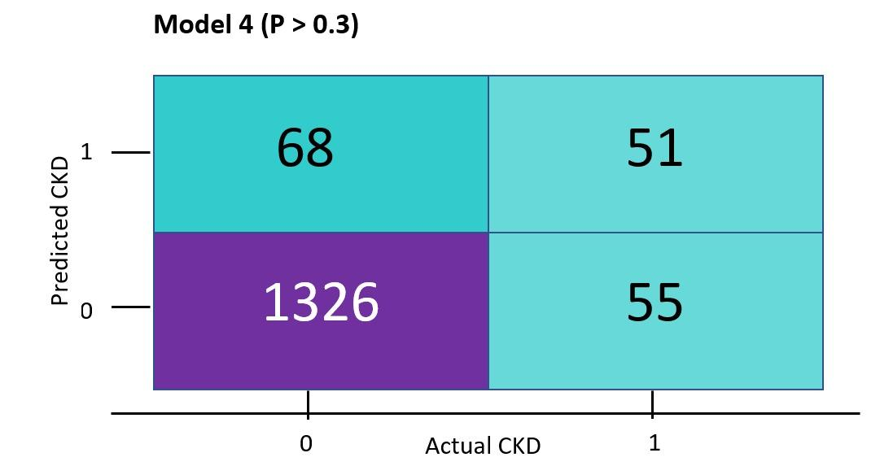
CONFUSION MATRIX

Slide 15
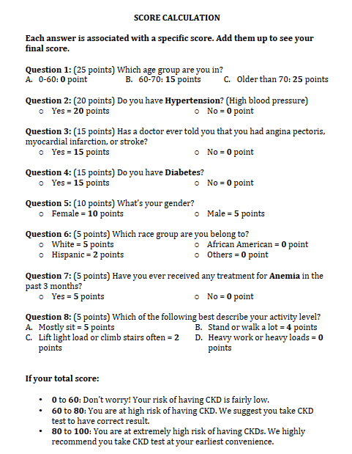
SCREENING TOOL

Slide 16
COMPARISION OF SCREENING TOOL AND MODELS
 | Thresholds | Accuracy | True Positive | False Positive | Profit
Model 3 | 0.5 | 93.13 | 19 | 16 | $23,100
 | 0.4 | 93.13 | 34 | 31 | $41,100
 | 0.3 | 91.6 | 48 | 68 | $55,600
Model 4 | 0.5 | 93 | 15 | 13 | $18,200
 | 0.4 | 92.5 | 33 | 39 | $39,000
 | 0.3 | 91.1 | 51 | 68 | $59,500
Screening tool | >60 | 88.33 | 58 | 127 | $62,700

Slide 17
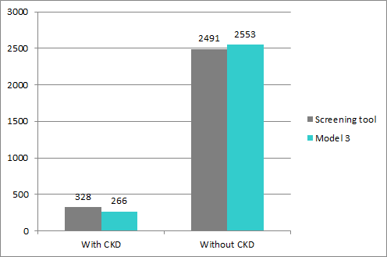
PREDICTION RESULTS

Slide 18
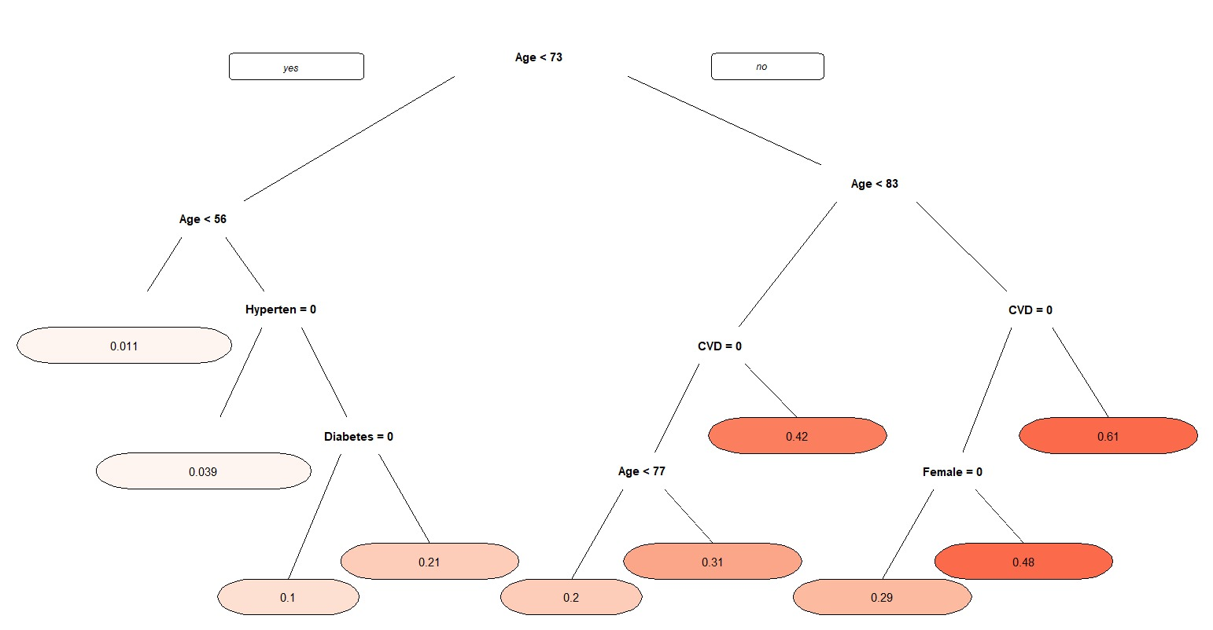
DECISION
TREE

Slide 19
THANK YOU

